Slide 1


Waste Awareness and Action to Reduce Household Waste
APSC 461
Nishtha, Cristian, Felipe, Diego, Dheeraj
Notes:
Hi everyone. My name is Nishtha and here is my team- cristian felipe diego & dheeraj. Our project is “Waste Awareness & Actions To reduce household waste”

Slide 2
Agenda
Introduction
Process & Method
Data
Survey Results
Recommendations
Challenges
Roadblocks
Notes:
Here is the agenda for today. We will begin by introducing our project followed by the process and method used in our project to gather results. Then we will share few numbers relevant to our project and then we will move on to discuss our most important survey results. Then we will move on to share some of the recommendations that we have concerning waste generation after our analysis and we will conclude our presentation by sharing the challenges that this project has and the roadblocks we faced as team in our journey.

Slide 3
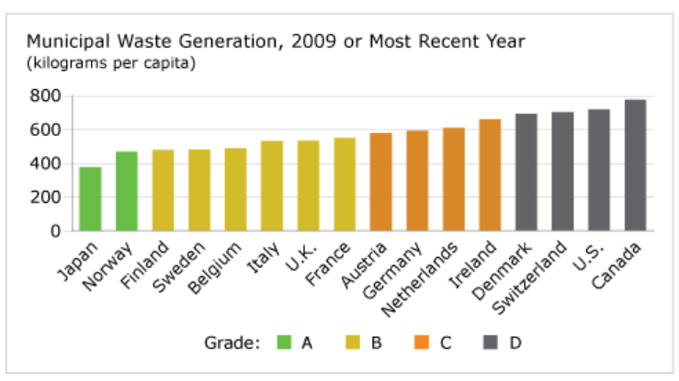
Problem
Rank = Last
Grade = D
Average= 720 kg of waste
per capita
Notes:
Lets begin with the problem! Municipal governments in Canada spent more than $3.2 billion on waste collection, transport, disposal, and diversion in 2012. These results are from January 2013 and we have the last rank and a ‘D’ grade on the international waste generation report card! Shiping our garbage under the pretext of recycling is not going to solve the problem. Waste generation should be controlled right here rather than facing garbage rejection from Malaysia & Philippines.

Slide 4
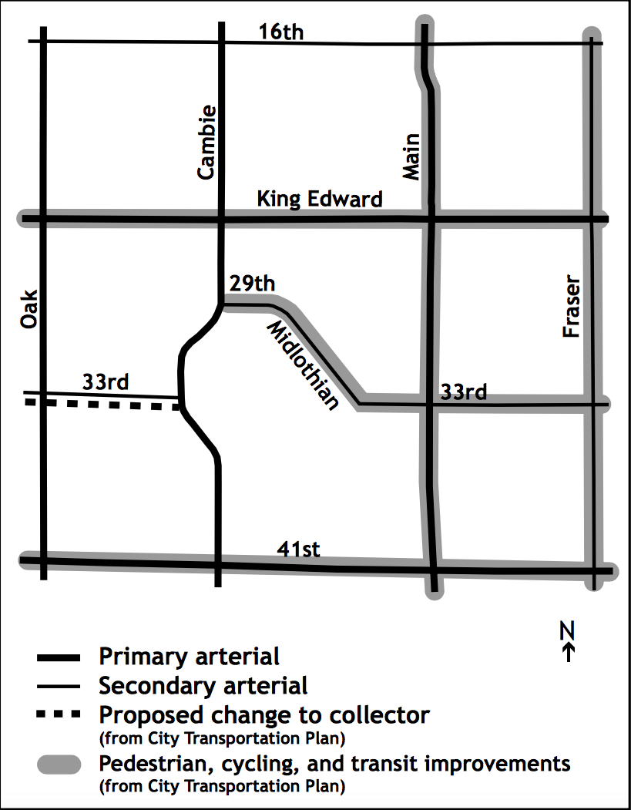
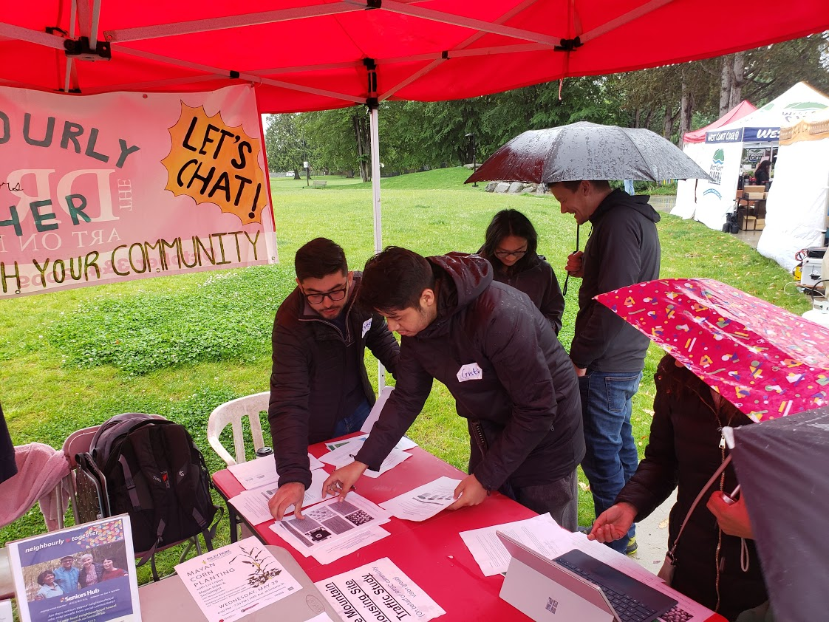
Introduction
RPSC Visions Group
Problem: Increased household waste despite recycling initiatives.
Vancouver Zero Waste 2040
Notes:
Increasing the amount of household waste that is recycled has become a major goal for the City of Vancouver during the last two decades. However, the amount of overall waste has not significantly declined.
2. The theme of our project is to engage the community to consider the amount and type of waste that it produces each week and consider steps that a family can realistically take to reduce the amount of material that it sends to the landfill
3. Our community Partner is RPSC- Riley Park South Cambie group which is an official Vancouver Community Vision group. The RPSC area extends from 16th to 41st Avenues between Fraser and Oak Streets. RPSC works with City Planning Department to provide input into planning and development initiatives in this area
Introduce Project - Theme, Community Partner & Boundaries!
Present the issues that make this project worthy of being carried out: Include the total waste generated in canada 1950 and now- show the increase
-Data about that vancouver: ?? Include only if the waste is increasing
-examples of countries accusing canada of dumping their waste Malaysia and Philippines have accused canada of shipping its waste. The problems needs to be solved here

Slide 5





Process & Methods
Elaborate questionnaire & tally sheet
Recruitment
Email invitation
Farmers market
Collect surveys
7-days waste tracking
Analyze results
& Conclusions
Notes:
Regarding our methodology and data acquisition, our team elaborated a survey about waste awareness and a tally sheet to track the waste of the participants during any 7 days period.
Our next step was participants recruitment, we send out an invitation to the community group members list and also presented our project in the local farmers market.
After, that we send out follow up emails with the survey link, tally sheet

Slide 6
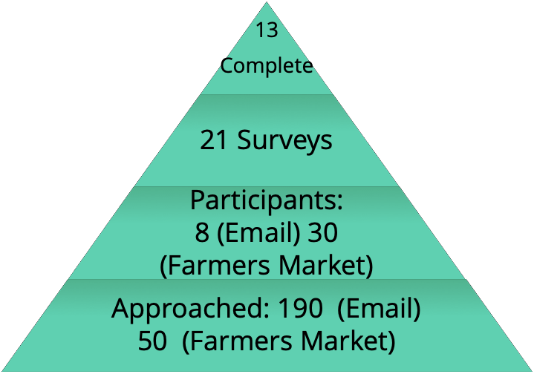
Participation
Notes:
To-do: MAKE A INVERTED PYRAMID /PIE CHART REPRESNTATION
Ask Norm how many people was reached out via email
Maybe mention that it was more effective to recruit people face-to-face (expand on this)

Slide 7
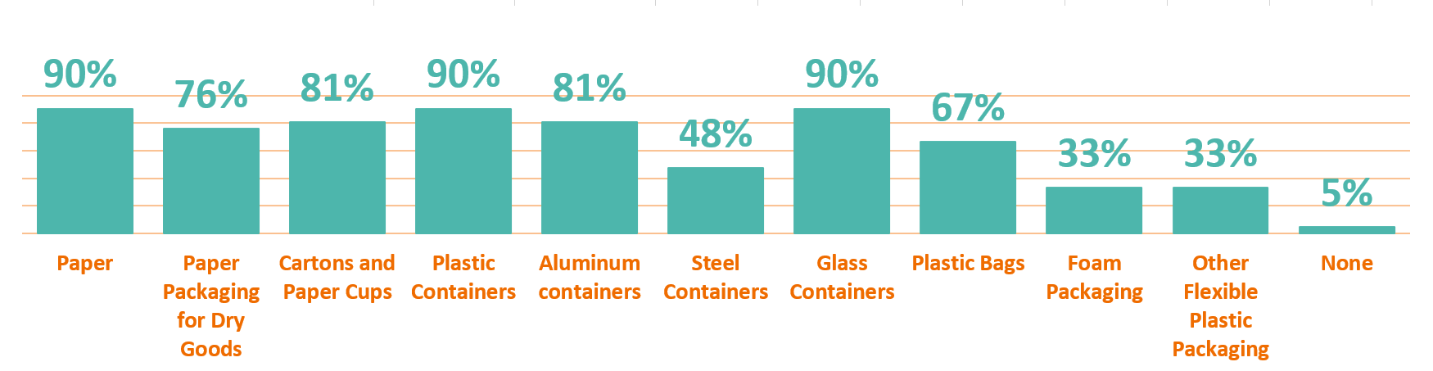
Survey Results
WHAT THEY RECYCLE:
Notes:
Half of the people do not know their collection schedule
→ This is the highlight of our survey. Pick the most & least recyclable item to discus! Highlight about foam packaging - depots!
Analysis: High levels of awareness regarding the importance of recycling
Need to educate people about recycling. When a person doesn’t know how to recycle an item, approximately half throw the item away -

Slide 8






Survey Results
90% said it’s extremely/very important that a business they frequent has recycling services
71% said they always/very often use reusable bags for grocery shopping
48% are not aware of the City's waste collection schedule for their area
33% don’t know that Recycle BC has a network of depots across BC
Notes:
Mention that this slide represents the level of waste awareness people have as of today-
ADD:
-Most of the people who took the survey were over 65 yo (NOT TRUE)
-Add Half of the people don’t know collection schedule - which is surprising considering the efforts that the City puts in regarding Waste Collection
-People want to recycle but things are not clear on how to do it & what goes where - big blockers!
ANALYSIS: High levels of awareness regarding the importance of recycling

Slide 9
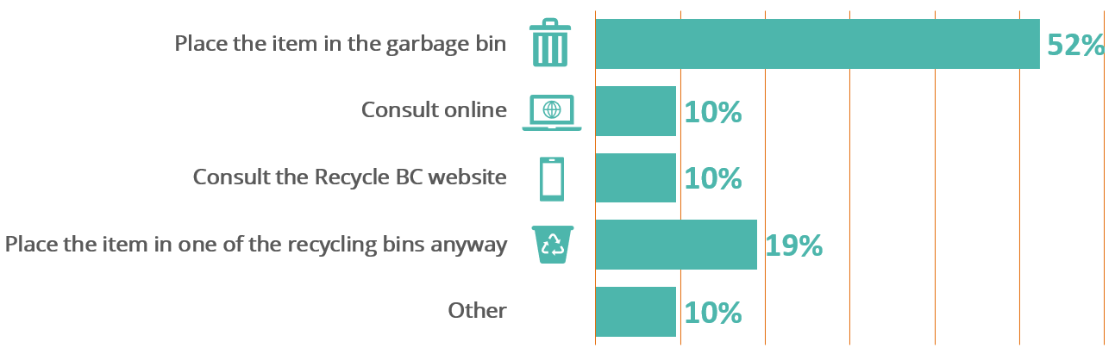
Survey Results
WHAT UNSURE IF AN ITEM IS RECYCLABLE:
Notes:
Half of the people do not know their collection schedule
→ This is the highlight of our survey. Pick the most & least recyclable item to discus! Highlight about foam packaging - depots!
Analysis: High levels of awareness regarding the importance of recycling
Need to educate people about recycling. When a person doesn’t know how to recycle an item, approximately half throw the item away -

Slide 10
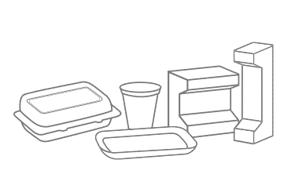
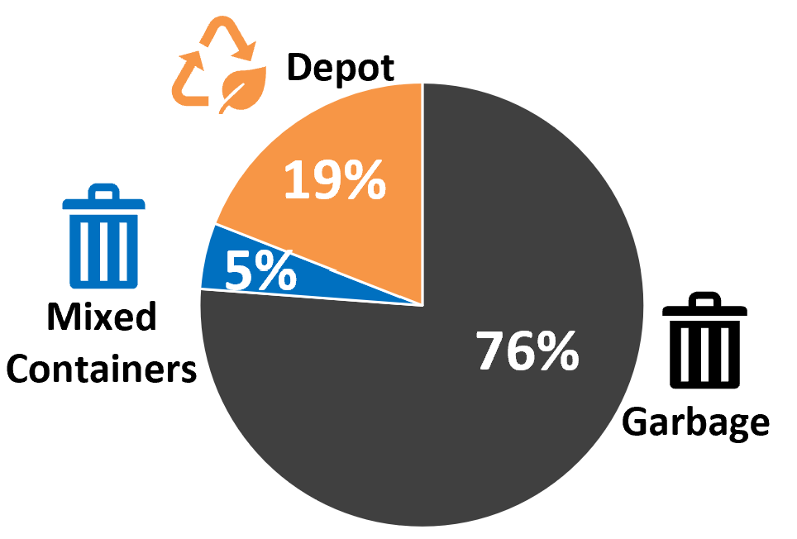
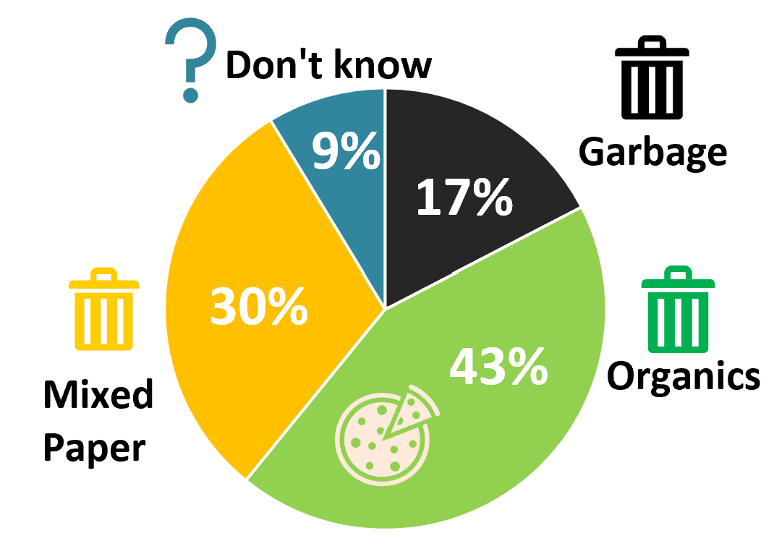
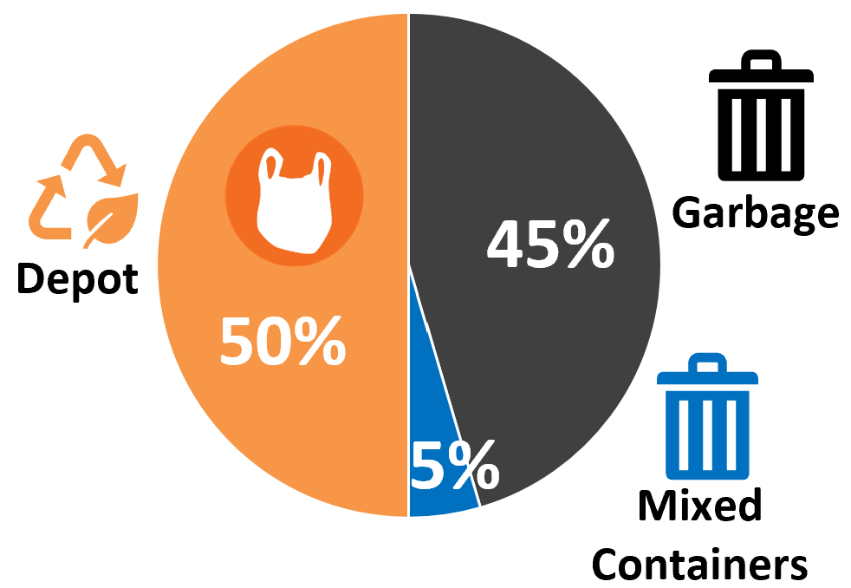
Survey Results: Commonly Confused Items
PIZZA BOXES:
FOAM CONTAINERS:
PLASTIC BAGS:
Average of 6 plastics bags are thrown away
Average of 10 Plastic bottles/containers are thrown away
Notes:
- Disposal Weekly Average: 6 plastic bags
Plastic bags can be recycled into new grocery bags, plastic pallets, containers, crates, pipes, decking and park benches.
Meat styrofoam trays - people feel helpless- meats are packaged in trays and you can not stack up the meat trays because they stink. So most of these are thrown out in garbage - Have more depots so people can easily throw off the foam trays in recycle depots

Slide 11
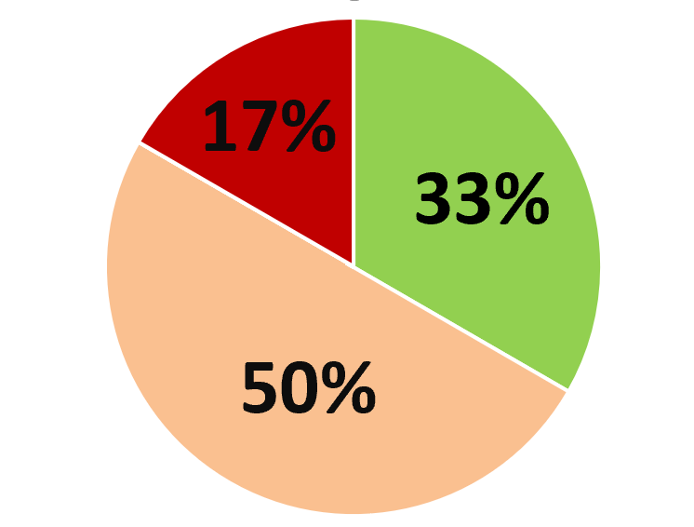
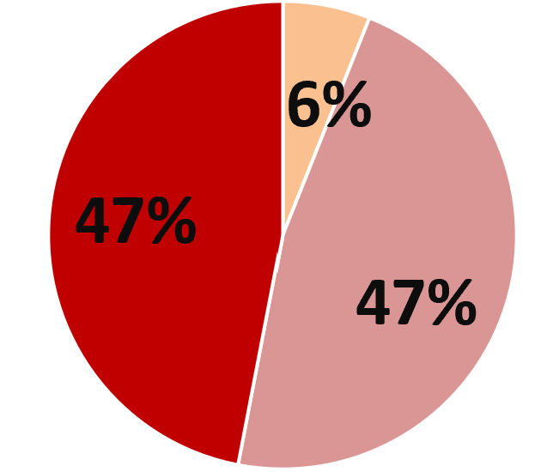
Survey Results
Satisfaction level with how the government is managing retail packaging for consumers:
10% 19% 33% 38%
Satisfied
Neither satisfied nor dissatisfied
Dissatisfied
Very dissatisfied
19-34 years old
+35 years old
Notes:
-Age distribution chart
Most participants 65+ year old (NO)
-most participants were 65+ - People want to recycle but there is no reference material at homes. People who are not tech friendly might not go to the website to check waste wizard tool. How to solve this: laminated reference sheet to be provided in each household, community workshops to educate people about recycling and waste sorting
Analysis: Overall dissatisfaction of how the government is managing retail packaging for consumers - slide 9

Slide 12
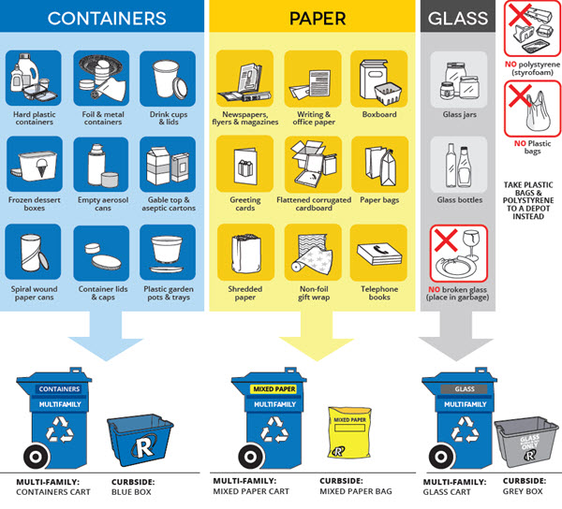
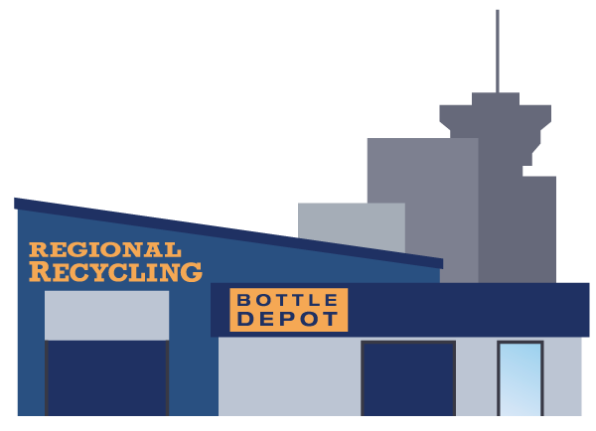
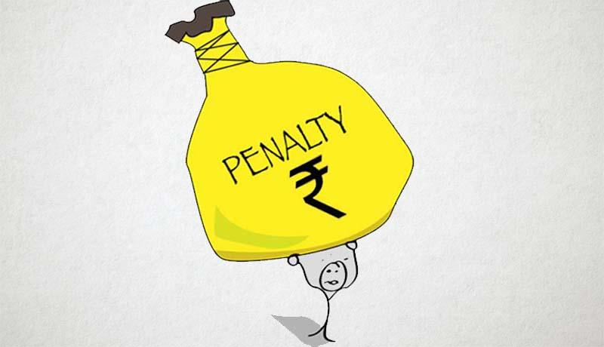

Recommendations
Notes:
USEFUL TALKING POINT:
-most participants were 65+ - People want to recycle but there is no reference material at homes. People who are not tech friendly might not go to the website to check waste wizard tool.
How to solve this: laminated reference sheet to be provided in each household, community workshops to educate people about recycling and waste sorting

Slide 13




Challenges
High Consumption
Pressure on Manufacturers
More taxes on Manufacturers

Slide 14
Roadblocks
Short Timeframe
Tally sheet - simplicity vs ambiguity
Recruitment of participants - in-person is more effective
Commitment from participants
Uncertainty about participant’s compliance in tracking waste - Reliability on the results
Tip: Continuous involvement with participants and community partners (frequent discussion and feedback)
Notes:
-Frame time
-Simplicity vs Ambiguity
Timeframe - not enough sample size of participants to rely on tally sheets
Tally sheet - simplicity vs ambiguity - hard to decide what to track & what to leave out
Commitment from participants
Hard to approach strangers and make a connection
Difficult to establish personal relevance to them
Uncertainty about participant’s compliance in tracking waste
In-person meetings are more effective

Slide 15

Q&A time

Slide 16
Critique - Backup Slide
What went well - Despite the weather , did a good recruitment - 30 people in farmer market,
Correlation b/w id number and survey - easy tracking
Where we lacked - Missed test run of tally sheet, books not in recycling
Future steps
Learning:
triggers thought when we throw items in waste
People are willing but lack of infra and clarity

